Slide 1

2021-22 Adopted Budget Report
Summary
San Ramon Valley Unified
June 15, 2021

Slide 2
Context
2
SRVUSD’s 2021-22 Adopted Budget Action (Last Board Meeting of the Year --- June 15th)
Sacramento’s 2021-22 Adopted Budget Action (prior-to June 30th)
SRVUSD’s “45 Day Revision” (August 2021) to Align with Sacramento’s Adoption
Start of School and Into the Fall Actual SRVUSD Enrollment (August to October 2021)
Next Major and Required 2021-22 Comprehensive Financial Budget Update = 2021-22 First Interim (December 2021)

Slide 3
Board Fiscal Oversight
3
State law requires all school districts to submit comprehensive financial reports aligned with the timeline below.
Sacramento also requires submission of the reports utilizing a proprietary format and accounting codes.

Slide 4
2021-22 Adopted Budget Report
4
Purpose
SRVUSD Board Oversight
Evaluate District’s Financial Position
Integral Component of Checks and Balances and Board Direction
Adopt Appropriate Certification (Criteria and Standards Reference)
Board Certifies:
Positive
Qualified
Negative
(Criteria and Standards Reference)
Result
Board Adoption → Report to Contra Costa County Office of Education → Report to Sacramento

Slide 5
Multi-Year Projection
2021-22 Adopted Budget
5

Slide 6
Multi-Year Projection
2021-22 Adopted Budget
6

Slide 7
Multi-Year Projection
2021-22 Adopted Budget
7

Slide 8
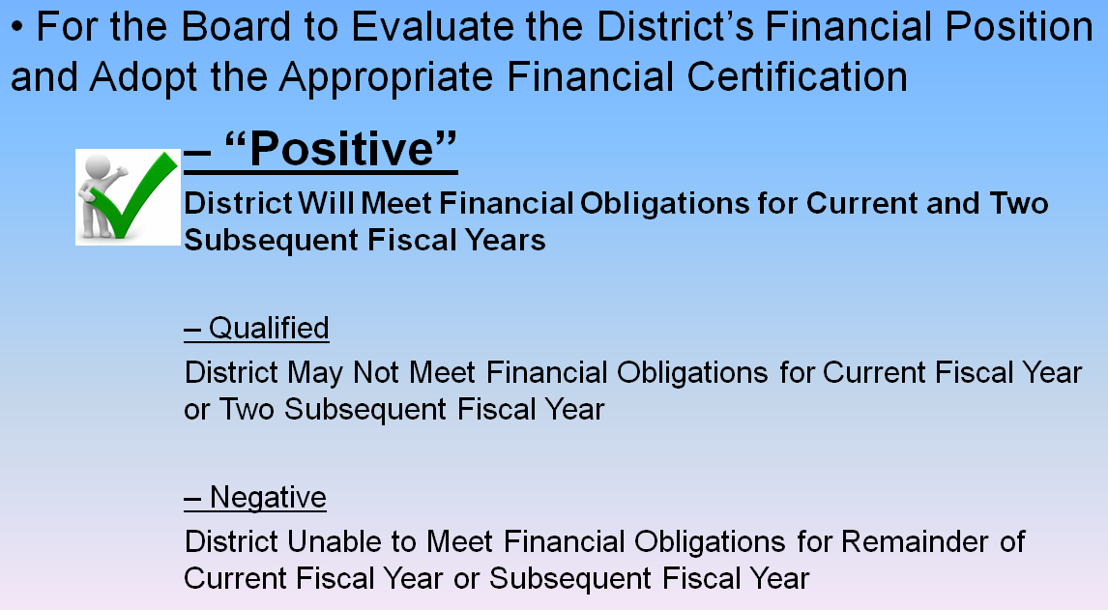
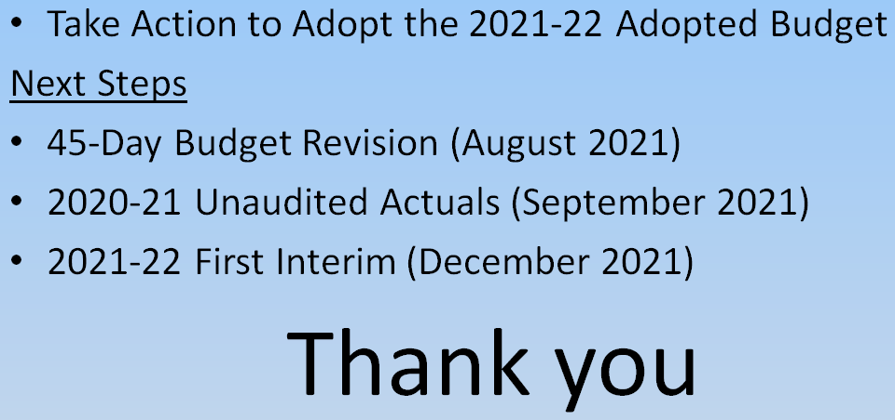
Staff Recommendation
8

